Slide 1
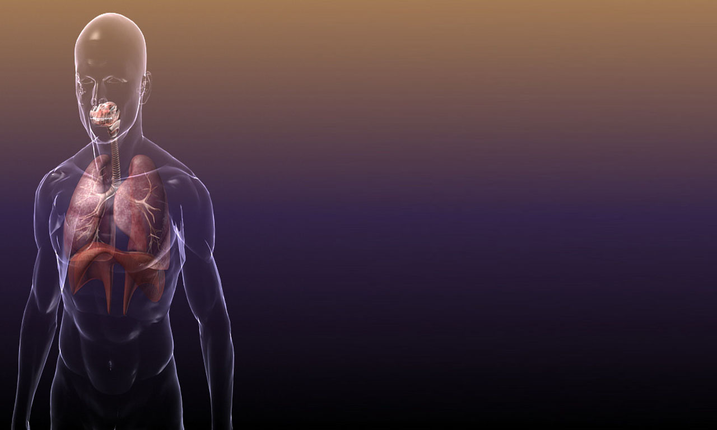

RESPIRATION
1. Respiration – basic life process
2. Respiratory system in humans
3. Gas exchange in lungs
4. Content of inhaled and exhaled air
5. Breathing and blood circulation

Slide 2



Respiration – basic life process
Essence of respiration:
Oxidation of nutrients
Energy release
...similar to burning

Slide 3



Summary:
Respiration – basic life process
Food (mainly glucose) “burns” using oxygen
Useful energy is released
Final products are carbon dioxide and water

Slide 4
Summary...
Respiration – basic life process
GLUCOSE
Oxygen
Energy
Carbon dioxide and water

Slide 5
Respiration as katabolic process in the cells runs in two stages...
Respiration – basic life process
Glucose
ANAEROBIC
ENERGY
PYRUVATE
Oxygen
ENERGY
AEROBIC
Carbon dioxide and water
Обратно

Slide 6
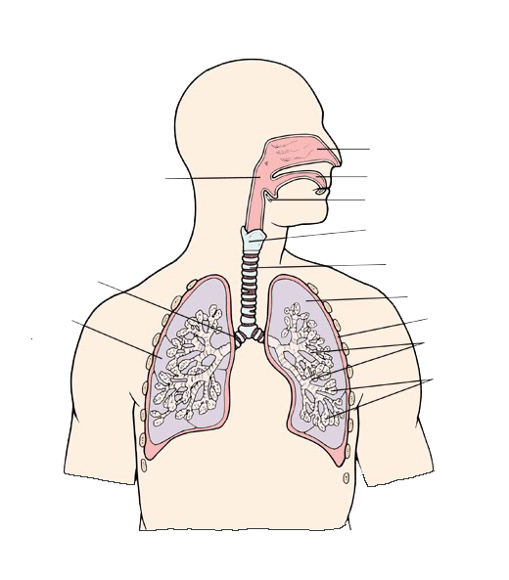
Respiratory System
Nasal cavity
Oral cavity
Pharynx
Epiglotis
AiR PASSAGEWAYS
Larynx
CENTRAL RESPIRATORY ORGAN
Bronchi
Trachea
Left lung
Right lung
Pleura
Bronchioles
Alveoli
Обратно

Slide 7
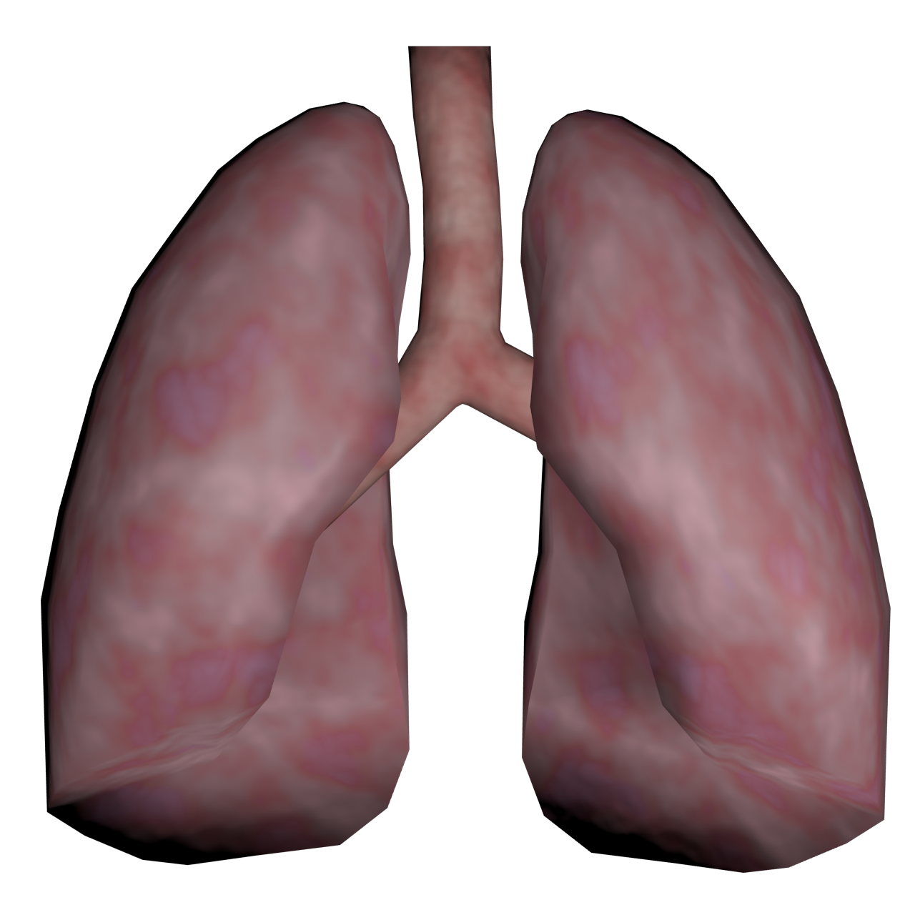
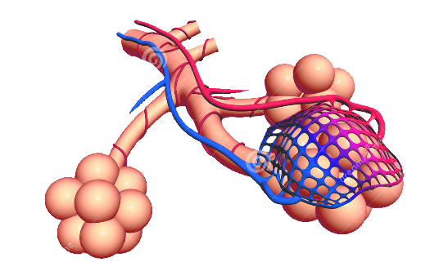
Gas exchange in the lungs
Important factors for the gas exchange:
1) The big total surface area of the alveoli
2) Moistened internal surface of alveoli
3) Permeability of their walls
In the lungs each bronchus branches into smaller bronchi, which branch into even smaller bronchi that in turn branch into bronchioles. They expand into thin-walled sacs called alveoli.
The clusters of alveoli are surrounded by networks of tiny blood vessels. They have thin walls and gasses pass by diffusion. The O₂ gets in the blood and CO₂ moves from the blood to the alveoli .

Slide 8
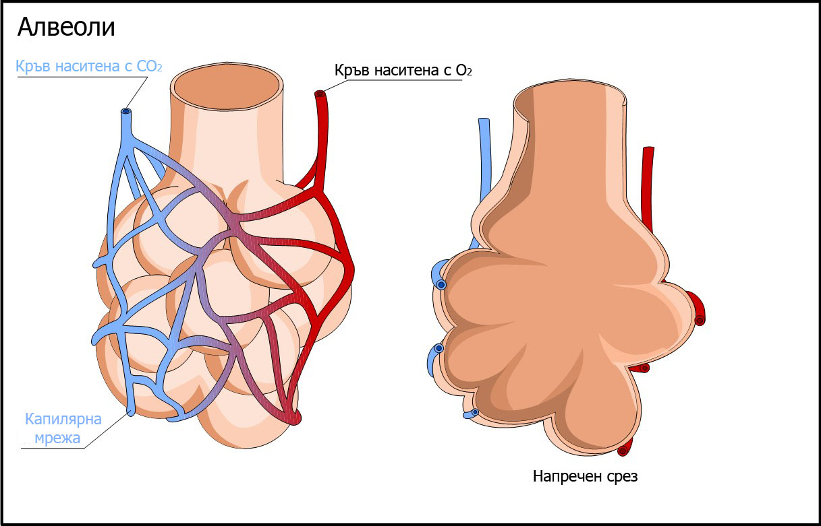
O₂
Gas exchange
The two gasses pass by the means of DIFFUSION from places with higher concentration to places with lower concentration .
CO₂
Обратно

Slide 9
Content of inhaled and exhaled air
Inhaled air
Exhaled air
0.03%
4%
17%
21%
78%
78%
Обратно

Slide 10
Respiration and Blood circulation
1) From the heart blood goes to the lungs where blood is oxygenated
2) Blood rich in O₂ backs into the heart
3) The heart pumps blood to the internal organs.…
5) Deoxygenated blood backs into the heart and the cycle starts again .
4)…and to the other parts of the body
( brings O₂ to the cells and takes from cells CO₂ )
Обратно

Slide 11



Educational Science Resource
created by Irina Kostadinova - biology and health education teacher
Second English Language School "Thomas Jefferson“
Sofia, Bulgaria

